Slide 1

CEIR User Management Feature -Training Manual

Slide 2

Agenda
Feature Overview
Stakeholder Overview
State Diagram
Features
UI Walk Thru
Register
Profile Management
Edit
Language Setting
Account Management
Disable Account
Enable Account
Login/Logout
Password Management
Forget Password
Reset Password
Deregistration

Slide 3


User Management
User Management feature allow stakeholder to register on CEIR portal and manage their profiles.
Using the feature, the system allows
Add a user (Registration)
Manage User Profile
3) Management User Account
Delete a user (De-registration)
View all users/details about a particular user
Manage Passwords
Adding feature to users as per grace period
Importers, Distributor, Retailer, Custom, Manufacturer,
TRC, Operator, End User, Immigration, Lawful Agency
Register, Edit
CEIR
System
Approve/Reject
CEIR Admin

Slide 4
Stakeholders
The following stakeholder will register themselves in the system
Importers
Distributors
Retailers
Customs
Lawful Agency
Immigration Front Desk
Operators
TRC
Each stakeholder is represented with a user Type in the CEIR system. Each user type is allocated a set of functionality for grace and post grace period.

Slide 5
Stakeholders
The following are the internal stakeholder who are configured at time of installation
System
>>> To configure various user and policy related parameters
CEIR Admin
>>> To approve / disapprove request as raised by stakeholder as part of various work flow

Slide 6
Registration – State Management
User
System
CEIR Admin
INIT
OTP Pending
Pending for CEIR Approval
Active
User disable the account
De-active
Register
Request
Start
Request
Submitted
User
Validate
Email/Phone no.
Approve
User enable the account
No action
In ‘N’ days
Reject
Rejected by System
User deactivate the account
De-Activate
Rejected by
CEIR Admin

Slide 7
User Management - Features

Slide 8
User Management - Features
CEIR provide self registration functionality so that user can register himself using the portal
Post successful registration, user can
Edit Profile
Deactivate account
Disable account
Enable Account
Change Password
Forget Password
Reset Password
Change Language
Edit Profile
Login/Logout

Slide 9
User to Feature Mapping Overview
SN | Stakeholder | Key Features
1 | Importer | Consignment, Stock, Grievance
2 | Custom | Consignment, Stock, Grievance, Individual tax paid
3 | Lawful Agency | Device Stolen / Recovery Cases, Grievance
4 | TRC | Type Approved TAC Devices
5 | Distributor, Retailer | Stock, Grievance
6 | Retailer | Stock, Grievance
7 | Operator | Block/Unblock Device, Grey/Black list file, Grievance
8 | Immigration | Manage user, Manage devices, Grievance
9 | End User | Update Visa/Register Device/check IMEI/upload stock

Slide 10
Password Management
The following policy is applicable for the password
Password should be minimum 8 chars with alphanumeric, with at-least 1 special character
Password would expire after 180 days (configurable)
Password can not be set which is same as last 3 passwords

Slide 11
Registration Flow
DMC Home Portal would have a link to register new users.
There could be multiple type of users like importer, distributor, retailer
All type of users would be listed down in the drop down order
User select the type with which he/she wish to register
On selecting the user type, the user is redirected to CEIR Portal
On CEIR Portal, user fill the registration form. The form has few values specific to the type of user

Slide 12
Registration
Once the form is submitted, then the user is asked to verify contact number and email ID on phone and email
Once the email is verified, the request is sent to CEIR Authority for approval
Once CEIR Authority approve the user, the user account is active

Slide 13
Registration – Form Description
The registration form has following key areas where information is collected
Type : Individual / Organization (Company or Government)
Information in case of Individual
National ID
National ID Image
Information is case of Company
Employment Details
Reporting Manager Information including contact information
Company name
VAT number
Information in case of Government
Employment Details
Reporting Manager Information including contact information
General Information
Address
Contact Information (Email and Phone number)
Security Related Questions, Password, Disclaimer

Slide 14
Stakeholder – Type Mapping
SN | Stakeholder | Type
1 | Importer, Distrbutor, Retailer | Company, Individual
2 | Custom, TRC, Lawful Agency, | Government
3 | Immigration, Operator | Company
4 | End User | Individual
All stakeholder except end user register themselves on the CEIR portal before using the service
End user can consume CEIR services without registration.

Slide 15
Stakeholder – Type and Field Mapping

Slide 16
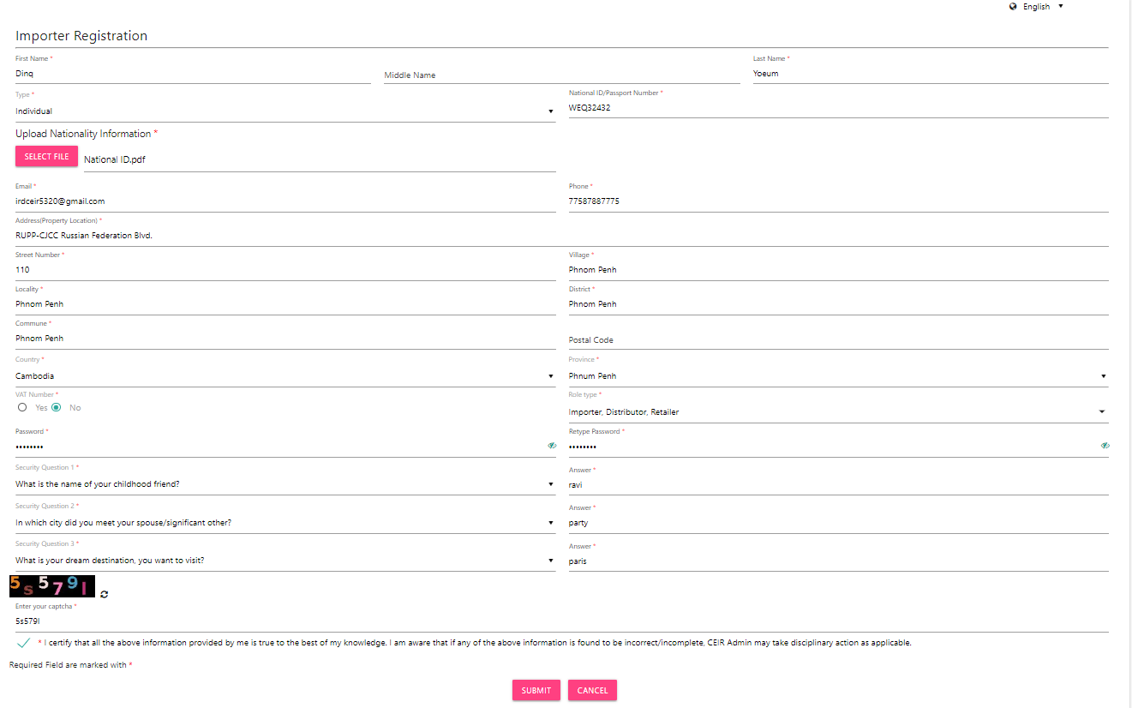
Registration – Flow

Slide 17
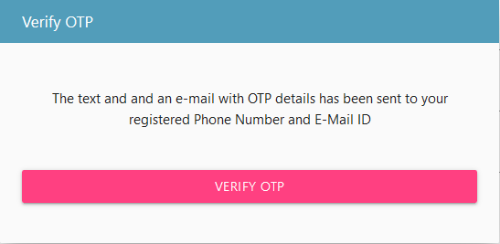
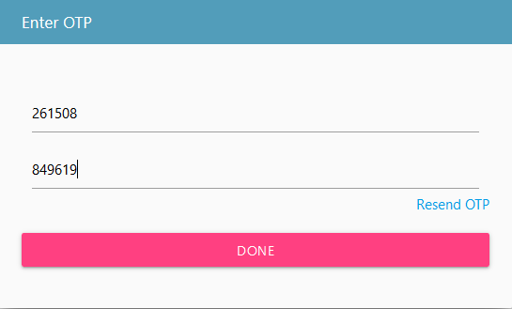
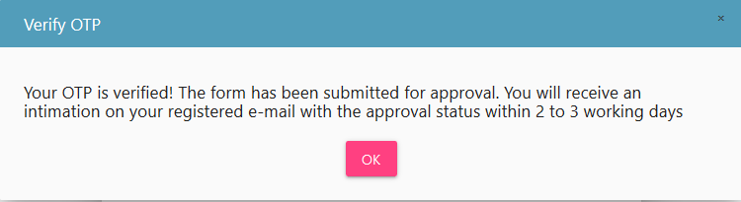
Registration – Flow

Slide 18
Registration – Post Flow
Once user has registered himself on the portal, user will be provided with login and password.
User can login into the CEIR system using these credentials

Slide 19
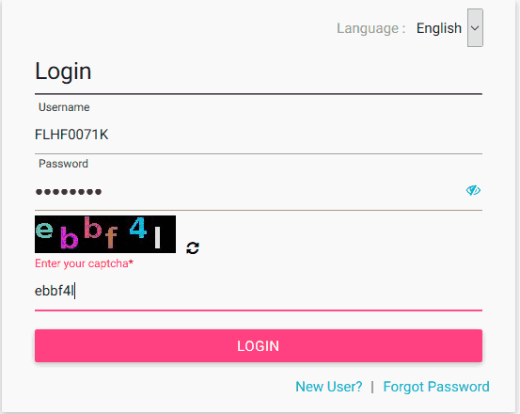
Login
Username is the registration ID that is sent on mail to the user after successful registration in the system.
The login password is the password that the user enters in the registration page

Slide 20
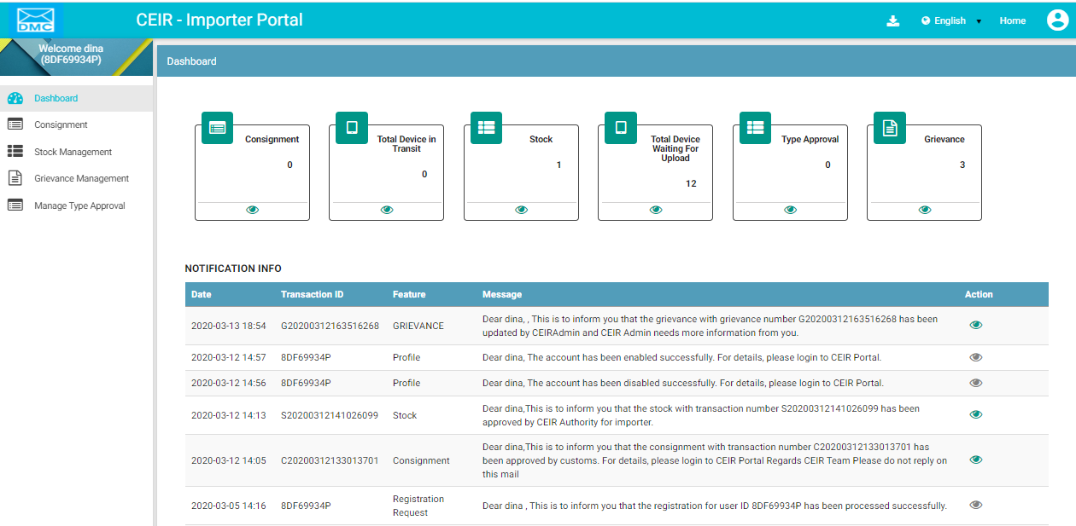
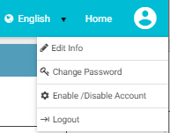
Post Login
Download Manual
Select
Language
Profile Menu
Feature
List

Slide 21
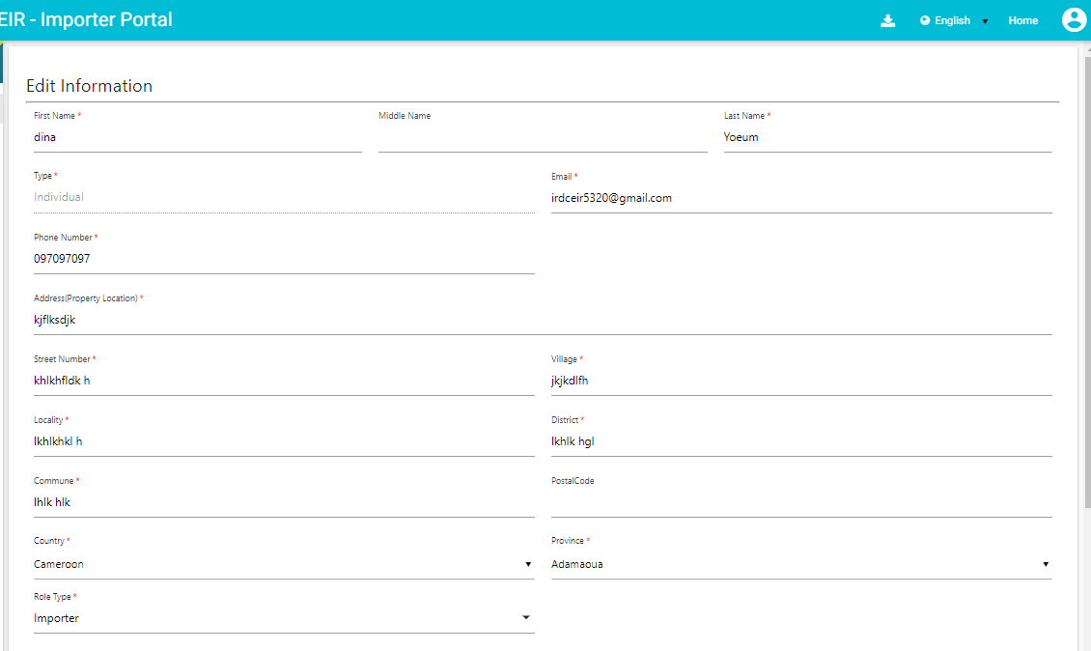
Edit Profile
Edit the profile as required

Slide 22
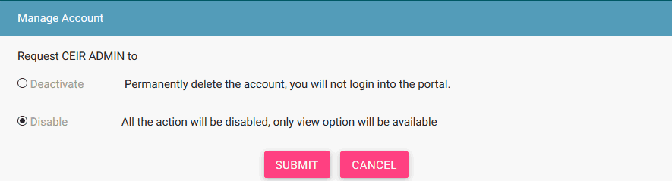
Account Managment
Deactivating an account means
deleting the importer’s account.
User can raise a grievance to
reactivate it when required.
When the account is disabled,
User can only view information
and not add or modify
information in the application.
After the account is disabled,
the importer can enable it using
the same menu.

Slide 23

Language Change
Two Language Support : English or Khmer.
All the field and column labels appear in the selected language.
User inputs are in English
Once the language is selected, it is saved in the profile. When user logins again, the page is displayed in the saved language

Slide 24
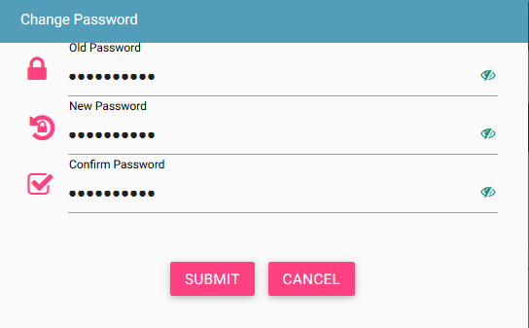
Change Password
While setting new password, kindly ensure that password policy is met.

Slide 25
Notification
Two Methods : SMS or E-mail.
SMS is sent to verify mobile number as entered in the registration page.
E-mail is sent
>> To Verify the email ID entered in the registration page
>> When user change password
>> When user forget password
>> When user disable the account
>> When user enable the account
>> When user deactivate the account
>> When user edit the profile
User inputs are in English
Once the language is selected, it is saved in the profile. When user logins again, the page is displayed in the saved language

Slide 26
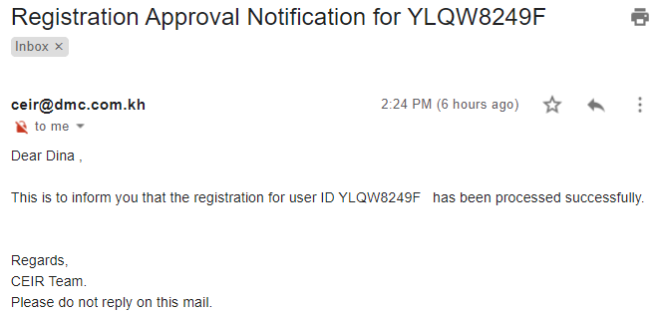
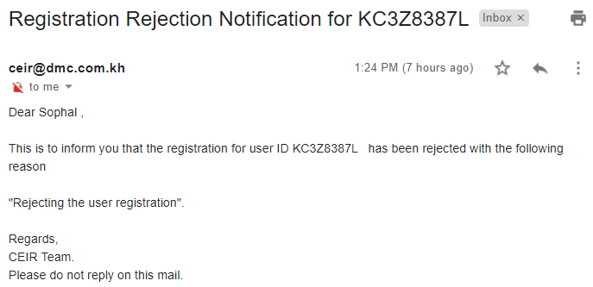
Email samples
Approved by CEIR
Rejected by CEIR
Email contents can be configured from the System Admin portal. This will be explained in detail in the system configuration training.

Slide 27
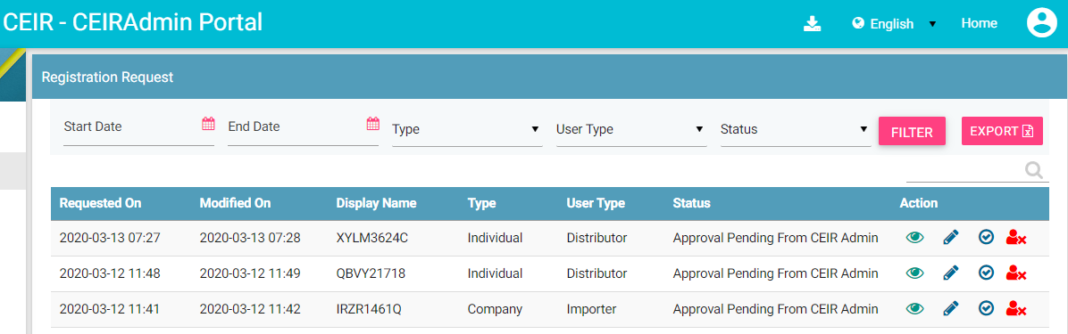
CEIR Admin Portal
By default, request with status “Pending approval from CEIR Authority” will be displayed in the CEIR Admin queue.
In case CEIR Admin wishes to view request in any other state, they can use the filter options to display the same.

Slide 28
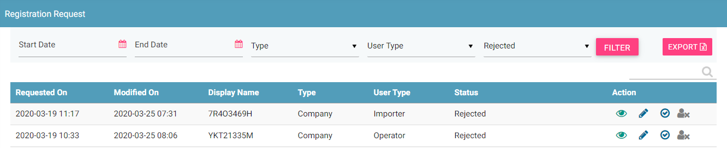
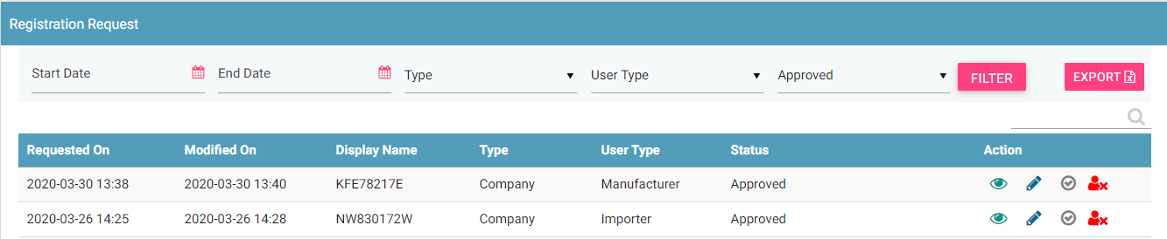
CEIR Admin Portal (contd.)
For request status as PENDING APPROVAL FROM CEIR AUTHORITY, actions like View, Edit, Approve, and Reject all will be enabled for CEIR Admin.
For status as REJECTED, actions like View, Edit, and Approve will be enabled for CEIR Admin.
For status as APPROVED, actions like View, Edit and Reject will be enabled for CEIR Admin.
All other states will have only View option enabled for CEIR Admin.

Slide 29
What next after Approval of User Registration ?
Simply, Login into the system and start using the system.

Slide 30
Queries

Slide 31
Thank You

